Slide 1
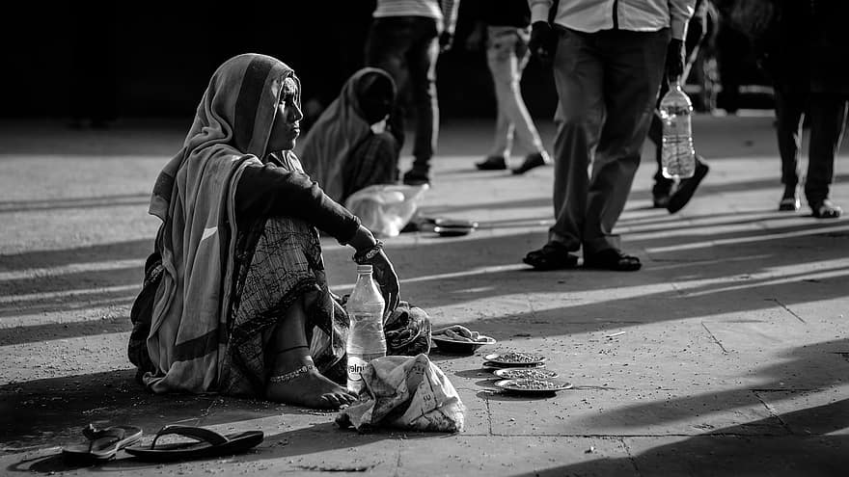
beggars

Slide 2
Statement:- beggars are unable to get out of beggary in india (bangalore) which effects their lives, increases poverty,etc.
SDG(susutainable development goals) :-
1- END POVERTY (MAIN)
2 - END HUNGER INTER-
3 - ENSURE HEALTHY LIVES LINKED

Slide 3
theme:- ACCESSIBILITY FOR BEGGARS
WHO ~ Beggars
WHAT ~ unable to get out of beggary
WHERE ~ in Bangalore
Leading effects ~ increase in poverty,
effects their lives,
etc.

Slide 4




Research & Presentation
BEGGARS

Slide 5



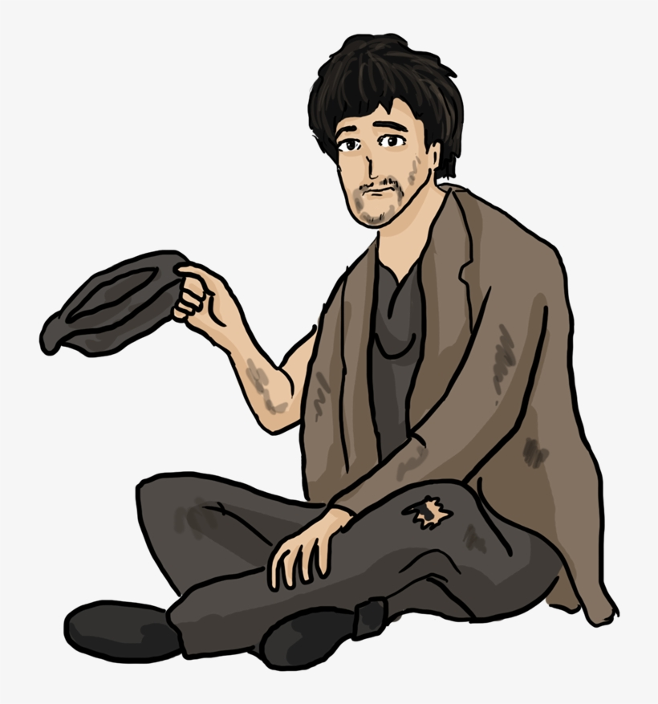
LITERACY RATE
1
2
The Census 2011 data released by the government showed some of the shocking facts about the beggar community of India. According to the data, India has 3.72 lakh beggars of whom 21 per cent are literate, having passed senior secondary certificate exams and above but they chose to beg as their degrees failed to land them appropriate job.
The population census carried out in 2011 revealed that there were 10,682 beggars in Karnataka
Out of the over 10,000 beggars, 2,547 are literate while 1,446 have completed high school.
As many as 459 beggars have studied up to Class X and Class XII.
In Bengaluru, 77 beggars are graduates/postgraduates while another 25 beggars have obtained technical diplomas. Another 206 beggars have studied up to Class X and Class XII in the city. Mysuru has the second highest number of "educated" beggars with 12 graduates.

Slide 6
Beggars, Vagrants etc
3
STATE | Persons | MALES | FEMALES
KARNATAKA | 12270 | 6436 | 5834
4
 | LITERATES | DEGREE HOLDERS
INDIA | 21%(78,120) | <3000
KARNATAKA | 2,547 | 77
INCLUDES PG’S , GRADUATES , DIPLOMA HOLDERS , ETC.

Slide 7

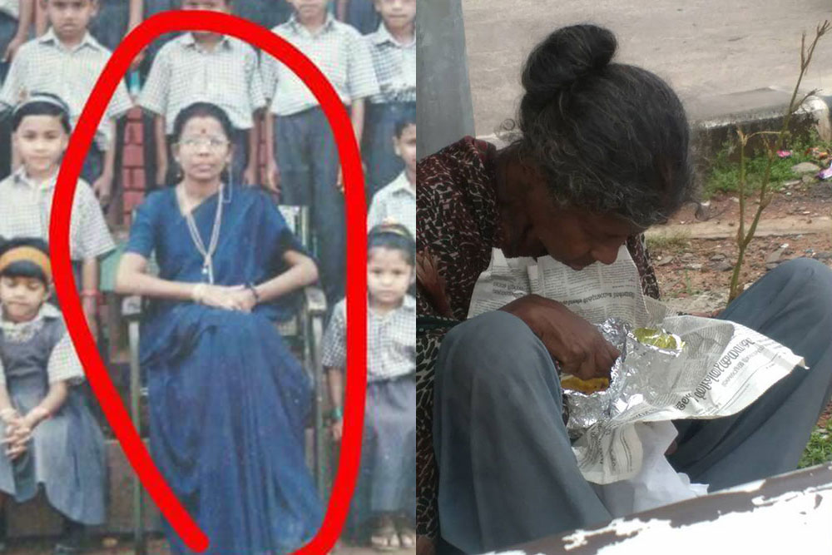
Beggars are choosing to beg…?
Dinesh Khodhabhai (45), a class 12 pass and is part of a motley group of 30 beggars who seek alms around Bhadra Kali temple in Ahmedabad said that by begging he earns more money. That’s why he chose begging over working.
A TEACHER TURNED HOMELESS & BEGGAR
I believe sometimes life takes everything away. I lost my job, my husband and children denied me, I was deprived from the basic necessities and gradually circumstances became worse and I became homeless before i knew. I was not a beggar but I became one and the hardest thing to do was to beg in front of my own children to help me pay the rent. After all that misery, pain was tolerable. There are days when I prefer earning it, instead of begging, so i do little bit of sweeping, unloading the farm trucks and in return get healthy fruits or a good meal. This entire phase to fight for food, shelter to even taking a shower, brings me to tears of hopelessness everyday because I feel I don’t deserve this.
when I was a teacher I used to make my students understand a lesson out of a story, so here I am trying to learn my share of lesson from my own story’.
Notes:
When conducting research, it is easy to go to one source: Wikipedia. However, you need to include a variety of sources in your research. Consider the following sources:
Who can I interview to get more information on the topic?
Is the topic current and will it be relevant to my audience?
What articles, blogs, and magazines may have something related to my topic?
Is there a YouTube video on the topic? If so, what is it about?
What images can I find related to the topic?

Slide 8



WHAT INDIAN GOVERNMENT IS DOING FOR BEGGARS ?
Recently, the Ministry of Social Justice and Empowerment has formulated a scheme SMILE - Support for Marginalized Individuals for Livelihood and Enterprise.
It includes a sub-scheme - ‘Central Sector Scheme for Comprehensive Rehabilitation of persons engaged in the act of Begging.
Currently, a pilot project of it is ongoing in 7 cities namely Delhi, Bangalore, Hyderabad, Indore, Lucknow, Nagpur and Patna.
Govt to rehabilitate 20,000 beggars over next five years
Read more at:
https://economictimes.indiatimes.com/news/india/govt-to-rehabilitate-20000-beggars-over-next-five-years/articleshow/88168403.cms?utm_source=contentofinterest&utm_medium=text&utm_campaign=cppst
https://www.drishtiias.com/daily-updates/daily-news-analysis/smile-scheme-1/print_manually
Notes:
Once you find your sources, you will want to evaluate your sources using the following questions:
Author:
Who is the author?
Why should I believe what he or she has to say on the topic?
Is the author seen as an expert on the topic? How do you know?
Current:
How current is the information in the source?
When was the source published?
Is the information out-of-date?
Accuracy:
Is the content accurate?
Is the information presented objectively? Do they share the pros and cons?

Slide 9
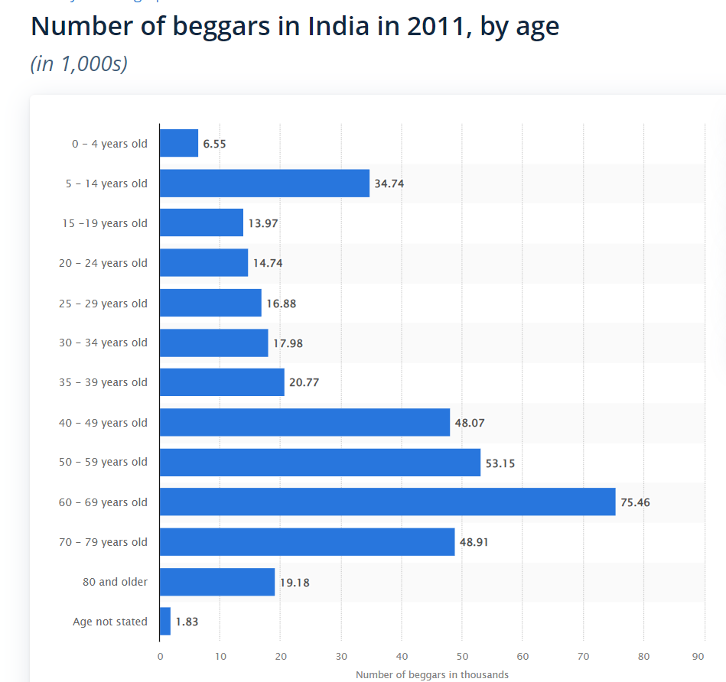
Notes:
After consulting a variety of sources, you will need to narrow your topic. For example, the topic of internet safety is huge, but you could narrow that topic to include internet safety in regards to social media apps that teenagers are using heavily. A topic like that is more specific and will be relevant to your peers. Some questions to think about to help you narrow your topic:
What topics of the research interest me the most?
What topics of the research will interest my audience the most?
What topics will the audience find more engaging? Shocking? Inspiring?

Slide 10
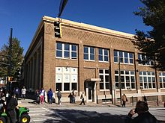
Homeless shelters are a type of homeless service agency which provide temporary residence for homeless individuals and families.
The Peachtree-Pine shelter in Atlanta, Georgia
And some of the NGO’s provide food for needy people.
Notes:
Now, that you have narrowed your topic, you will want to organize your research in a structure that works. There are some common organizational patterns based on the kind of research you are doing.
Organizational Structures:
Cause and Effect- this kind of structure is great for explaining the causes and effects of a topic
Compare and Contrast- in this pattern you highlight the similarities and differences of the topic
Explain process- this structure is great for outlining a series of steps to follow;
Definition- if you want to make sure your audience understands what something is using illustrations, meanings, clarifying misconceptions, you may want to use this structure
Classification- a common organizational structure is grouping like topics or facts from the research together. For instance, in the internet safety about social media apps, you may organize the research where you look at each social media app one at a time

Slide 11
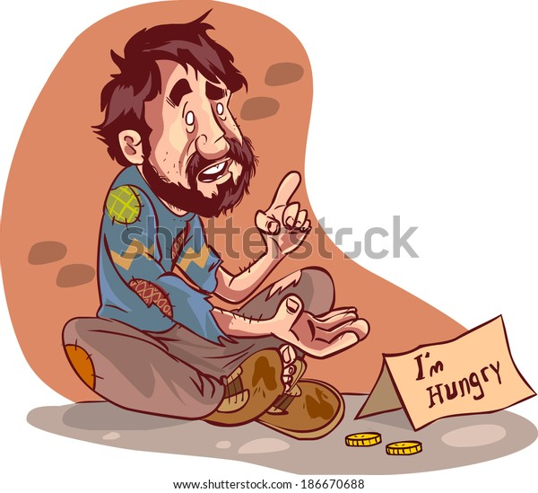
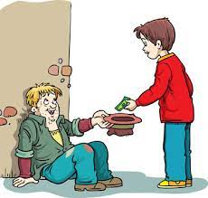
What are the root causes of beggary?
Unremunerative agriculture, poverty, unemployment and disruption of joint family and of caste control are the major causes of increase of beggary in India.
Notes:
After you’ve done your research, it’s time to put your presentation together. The first step in the process is to introduce the topic. This is a great time to connect your topic to something that your audience can relate. In other words, why should they listen to all the information you will be sharing in your research presentation? What is in it for them? You may also want to include a graphic or image to grab their attention.
Feel free to duplicate this slide by right-clicking on this slide in the slides pane to the left and select Duplicate Slide.
The next step in your presentation is to state your claim or topic clearly. Your teacher may even call this your thesis. As you state your thesis, you may find that this layout is not the best layout for your claim or topic. You can change the layout by clicking the drop-down menu next to the Layout in the Slides menu section. You can choose Two Content, Comparison, or Picture with Caption. Note: A different layout might change the look of the icons on this page.
You will also want to state your facts. You have done the research now share some of the interesting facts with your audience. Facts do not have to be boring; you can communicate facts in a variety of ways by going to the Insert Tab. In the Insert tab you can:
Insert pictures from your computer or online.
Add a chart
Create some SmartArt
Insert a variety of icons to help your facts come to life. Note: You can change the color of the icons by selecting the icon and then click on the Format tab and then Graphics Fill. From there, you will choose a color from the list or choose More Fill Colors to give you more options.
Since this research presentation is a result of your hard work and searching, you want to make sure you support the claims or points in your presentation with facts from your research findings. Make sure you give the author proper credit for helping you share your ideas. If one of your sources has a video that is relevant to your topic, you can add the video as added support. Keep in mind the length of the video and the amount of time you have for your presentation. For a 5 minute speech, the video should be no longer than 30 seconds.
Questions to consider:
How will you state the author of the source?
Will you need to cite the source on the slide?
What are some ways you can engage your audience so they feel like they are a part of the presentation? Some ideas to consider is by taking a quick poll like: by a show of hands, how many of you think school uniforms are a way to cut down on bullying? Another suggestion is to have them hold up a certain number of fingers to see if they agree or disagree. Finally, you can share a story that the audience can relate to that makes them laugh.
After all the applause, your audience may have some questions. Be prepared to answer some of their questions by making a list of questions you think they might ask. You may also want to share the presentation with them by providing the link to your presentation, if they want more information.

Slide 12
Research Presentation End
THANK YOU
Notes:
You can use this slide as your opening or closing slide. Should you choose to use it as a closing, make sure you review the main points of your presentation. One creative way to do that is by adding animations to the various graphics on a slide. This slide has 4 different graphics, and, when you view the slideshow, you will see that you can click to reveal the next graphic. Similarly, as you review the main topics in your presentation, you may want each point to show up when you are addressing that topic.
Add animation to images and graphics:
Select your image or graphic.
Click on the Animations tab.
Choose from the options. The animation for this slide is “Split”. The drop-down menu in the Animation section gives even more animations you can use.
If you have multiple graphics or images, you will see a number appear next to it that notes the order of the animations.
Note: You will want to choose the animations carefully. You do not want to make your audience dizzy from your presentation.

Slide 13
WHY BEGGARS CHOOSE TO BEG?
THEY CHOOSE IT FOR PROFITS
THEY ARE EARNING MORE MONEY THAN THE SALARY THEY GET FOR JOBS.
EASY MONEY
ZERO INVESTMENT MAX PROFIT
THEY HAD TO CHOOSE IT TO SURVIVE
Miserable life crisis.
Unemployment because of illiteracy and other factors
They didn’t get any source of income.
Orphans , physically disabled, etc.
Orphans
Abandoning
early age pregnancy
Financial crisis
Physically disabled because of accidents and diseases
Death of caretakers
Because of their family

Slide 14
HOW MIGHT WE EDUCATE TEENAGE GIRLS ABOUT HARMFUL EFFECTS OF EARLY AGE PREGNACIES IN ORDER TO PREVENT THEM???????

Slide 15
BRAINSTORM IDEAS???
WHAT IF WE COULD CREATE AWARENESS ABOUT CONTRACEPTIVE METHODS AND PREVENT UNWANTED PREGNANCIES AMONG GIRLS WHO ARE YOUNG AND THOSE WITH FINANCIAL PROBLEMS?
WHAT IF WE COULD CREATE AWARENESS AMONG PARENTS ABOUT HARMFUL EFFECTS OF CHILD MARRIAGE WHICH LEADS TO EARLY AGE PREGNANCIES IN A VERY YOUNG AGE ?
WHAT IF WE COULD CONDUCT INTERVIEWS WITH THE VICTIM WHO HAS FACED THIS ISSUE AND TELECAST SO THAT CAN CHANGE THE MINDSETS OF TEENAGERS ?
WHAT IF WE COULD MAKE FILMS OR SERIES ON THIS TOPIC SHOWING THEIR HARMFUL EFFECTS TO CREATE AWARENESS??
WHAT IF WE COULD CREATE ADS AND SPREAD THEM TO CREATE AWARENESS ABOUT EARLY AGE PREGNACIES AND THEIR PROBLEMS INORDER TO PREVENT THEM?
WHAT IF WE COULD CONDUCT SOME RALLIES AND EVENTS TO SPREAD AWARENESS ABOUT THE EFFECTS OF CHILD MARRIAGES AND EARLY AGE PREGNANCIES?
WHAT IF WE CAN ALSO EDUCATE BOYS ABOUT HARMFUL EFFECTS OF EARLY AGE PREGNANCIES AND HOW WILL THEY RUINS THEIR CAREERS ? CREATING AWARENESS AMONG BOYS??
WHAT IF WE CAN CREATE AWARENESS WITH THE HELP OF SEX EDUCATION CLASSES FOR THE CLEAR UNDERSTANDING OF TEENAGERS??
WHAT IF WE CAN CREATE AWARENESS AMONG SEX WORKERS ABOUT CONTRACEPTIVE METHODS TO PREVENT UNWANTED AND SOMETIMES EARLY AGE PREGNANCIES?
WHAT IF WE COULD COLLECT SOME REAL LIFE EXPERIENCES OF THE PEOPLE AFFECTED FROM EARLY AGE PREGNANCIES AND SHARE INFORMATION WITH THE TEENAGERS?

Slide 16
FINAL IDEAS
WHAT IF WE COULD COLLECT SOME REAL LIFE EXPERIENCES OF THE PEOPLE AFFECTED FROM EARLY AGE PREGNANCIES AND SHARE INFORMATION WITH THE TEENAGERS?
WHAT IF WE CAN CREATE AWARENESS AMONG SEX WORKERS ABOUT CONTRACEPTIVE METHODS TO PREVENT UNWANTED AND SOMETIMES EARLY AGE PREGNANCIES?
WHAT IF WE CAN ALSO EDUCATE BOYS ABOUT HARMFUL EFFECTS OF EARLY AGE PREGNANCIES AND HOW WILL THEY RUINS THEIR CAREERS ? CREATING AWARENESS AMONG BOYS??
WHAT IF WE CAN CREATE AWARENESS WITH THE HELP OF SEX EDUCATION CLASSES FOR THE CLEAR UNDERSTANDING OF TEENAGERS??
WHAT IF WE COULD CREATE AWARENESS AMONG PARENTS ABOUT HARMFUL EFFECTS OF CHILD MARRIAGE WHICH LEADS TO EARLY AGE PREGNANCIES IN A VERY YOUNG AGE ?

Slide 17
SOURCE OF NEEDS
EDUCATING TEENAGERS ABOUT EARLY AGE PREGNANCIES

Slide 18
TOPICS
BY GOING TO SCHOOLS AND EDUCATE THEM ABOUT THE HEALTH ISSUES THEY MIGHT FACE LIKE STDs.
SHARING THE REAL LIFE EXPERIENCES OF EFFECTED PEOPLE TO TEENAGERS.
MAKE THEM AWARE OF SEX EDUCATION.
CREATING AWARENESS ABOUT CONTRACEPTIVE METHODS SUCH AS BIRTH CONTROL PILLS.

Slide 19
CONTEXT
EDUCATING TEENAGERS ABOUT EARLY AGE PREGNANCIES IN ORDER TO PROVIDE SEX EDUCATION

Slide 20
PAINS & GAINS
THEY WILL KNOW HOW TO TAKE CARE OF THEIR HEALTH .
SEX EDUCATION PROVIDES TEENAGERS THE KNOWLEDGE THEY NEED FOR A HEALTHY LIFE.
THEY WILL BE AWARE OF STDs AND CAN PREVENT THERM.
SEX EDUCATION INCREASES YOUNG PEOPLE’S KNOWLEDGE AND IMPROVING THEIR ATTITUDES RELATED TO SEXUAL AND REPRODUCTIVE HEALTH AND BEHAVIOURS.
THE AIM OF SEX EDUCATION IS TO TEACH PEOPLE HOW TO MATTERS CONCERNING SEX , SEXUALITY , AND SEXUAL HEALTH.
IT ALSO PROVIDES INFORMATION ABOUT PUBERTY AND CHANGES WHILE PUBERTY TO TEENAGERS.

Slide 21
CASE STUDY : SEX EDUCATION BY DEBADITYA SEKHAR JENA
Education is important for personal growth and development. However, over the last decades we have failed to develop our education system to accommodate changing needs of students and society in general. Sex Education has been described as an impossible programme to introduce in our country. Families, educational institutes, policymakers all refuse to acknowledge its requirement in our nation. This design project looks at the pros and cons of sex education in India and delivers a democratic solution to give people a safe alternate way to explore the world of sex and sexuality.
https://bootcamp.uxdesign.cc/wait-sex-education-in-india-a054dc6a62f8

Slide 22
Based on desirability, viability and feasibility,
The final idea, we have choosen to give sex education to teenagers is through “PAMPHLETS”

Slide 23
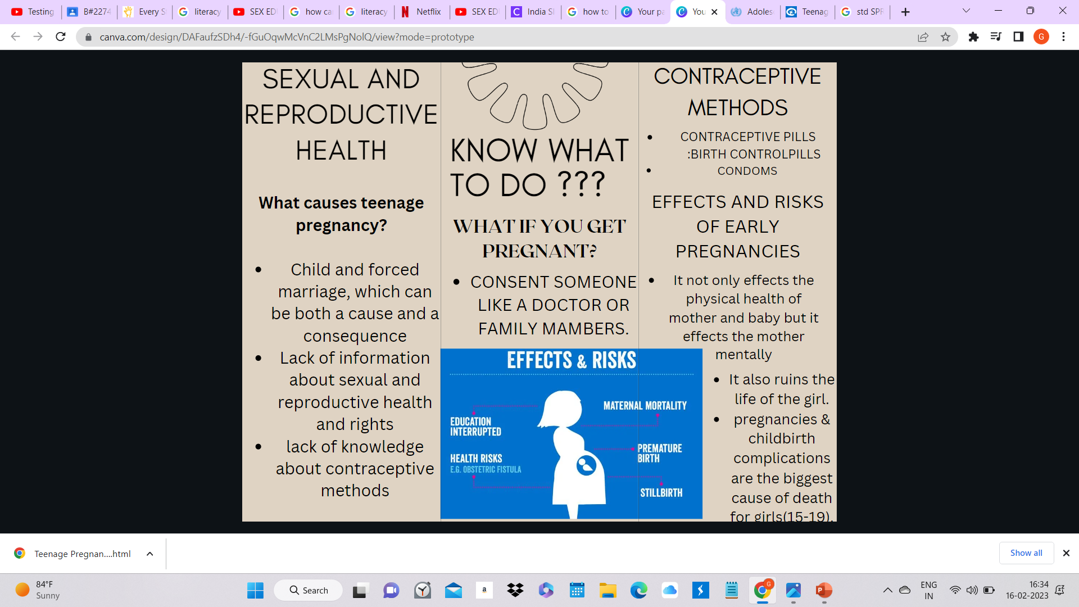

Slide 24
